Slide 1








VIDEO PORTFOLIO SITE
Prepared By :
Rathod Brijeshkumar Mukeshbhai
Roll no: 48
Enrollment No: 22002171220043
Batch: D2D-2 Branch: CSE-D2D

Slide 2


PROJECT OUTLINE
Idea that lead to the concept
The concept of a video portfolio site is designed to make it easier for video professionals to showcase their work, connect with potential clients or employers, and ultimately grow their businesses or careers.

Slide 3
PROJECT OUTLINE
Functionality :
Home Page
Portfolio Page
About Page
Contact Page
Navigation Menu
Responsive Design

Slide 4
PROJECT OUTLINE
Components used
HTML and CSS: HTML is used to structure the site's content, while CSS is used to style it. Together, they form the backbone of any website.
JavaScript: JavaScript is a programming language used to add interactivity and dynamic features to websites. It can be used to create responsive designs, add animations, and implement other advanced features.
Bootstrap: Bootstrap is a popular front-end framework that provides a set of pre-built UI components and responsive design features. It can be used to create a consistent look and feel across the site and ensure that it looks good on all devices.
jQuery: jQuery is a JavaScript library that simplifies the process of working with HTML documents, handling events, and creating animations.
Video players: Video players such as YouTube, Vimeo, or HTML5 video players can be embedded in the site to display video content.

Slide 5



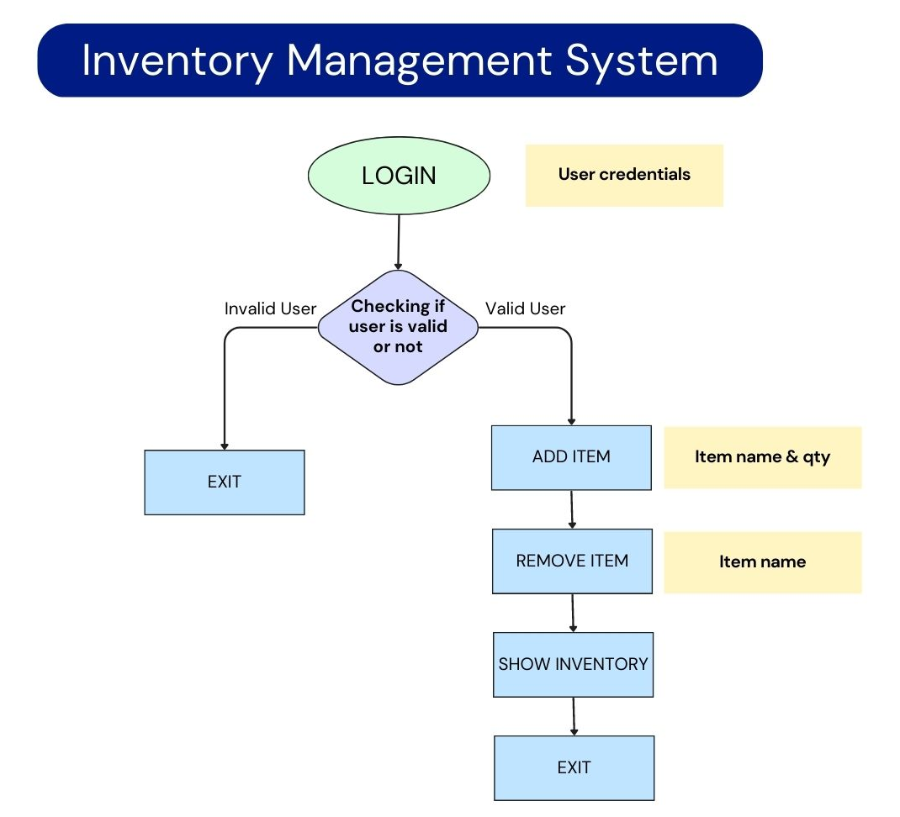

Circuit diagram/Block diagram:-

Slide 6




References :
https://github.com/themefisher/thomson
Future Scope :
Integration with other systems: The program can be integrated with other business systems, such as accounting or order management, to create a more comprehensive solution.
Real-time tracking: The program can be enhanced to provide real-time tracking of inventory levels and automatically update the inventory when a new order is placed or when items are received.
Reporting and analysis: The program can be extended to include reporting and analytics capabilities, such as generating reports on inventory levels, sales, and other key metrics.
User may Create their Shops.

Slide 7




THANK YOU

